Slide 1
Fundamentals of Deep Learning with Computer Vision and Natural Language Processing Exercises on Google Co-lab
Yalong Pi
Associate Research Scientist
Texas A&M Institute of Data Science
Nov 17 @ 9:00 am – 5:00 pm

Slide 2
https://github.com/TAMIDSpiyalong/2025-Texas-GIS-Day
Co-lab code
PPT
Dataset

Slide 3
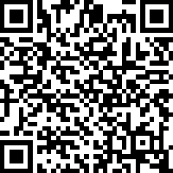
[9:00-9:20] Survey

Slide 4
Agenda (morning)
[9:00-9:20] Survey
[9:20-9:40] Intro
[9:40-9:50] Break
[9:50-11:00] Neural network principles
[11:00-11:10] Break
[11:10-11:30am] Lab1 first half
[11:30-12:30 pm] Lunch break at OMB lobby

Slide 5
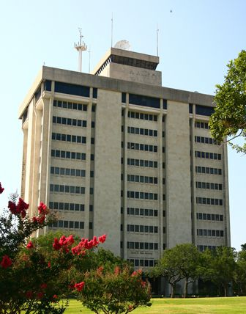
Lunch: 11:30 AM - 12:30 PM
Eller Oceanography & Meteorology Building
Building 0443
797 Lamar St, College Station, TX 77843

Slide 6
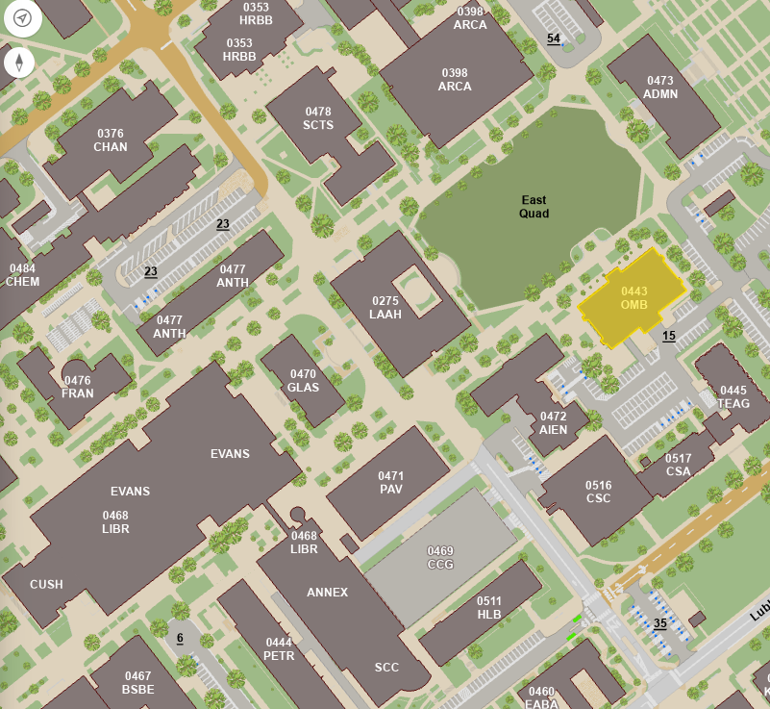

Slide 7
Agenda (afternoon)
[1:00-1:20] Convolutional neural network
[1:20-1:40] Lab1 second half
[1:40-2:00] Data augmentation
[2:00-2:20] Lab2
[2:20-3:20] Tokenization and embedding
[3:20-4:00] Lab3
[4:00-4:20] Transformer and generative AI
[4:20-4:40] Lab4
[4:40-5:00] Survey

Slide 8
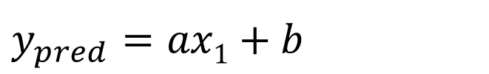
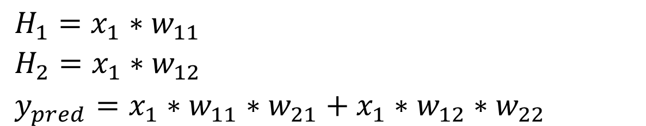
y
$y_{pred}$ $=ax1+b$
H₁
30
w₁₁
w₂₁
x₁
y
20
w₂₂
w₁₂
H₂
10
0
1
2
5
x
$H_{1}=x_{1}∗w_{11}$
$H_{2}=x_{1}∗w_{12}$
$y_{pred}=x_{1}∗w_{11}∗w_{21}+x_{1}∗w_{12}∗w_{22}$
x | y
1 | 10
2 | 20
5 | 30

Slide 9
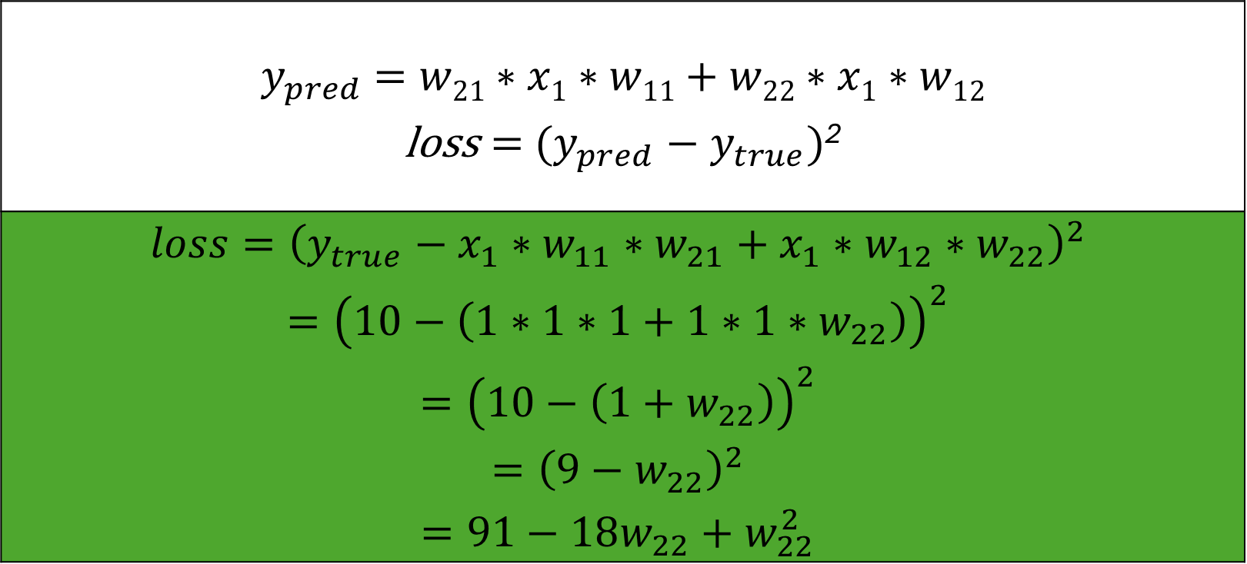
$y_{pred}$ $=w21∗x1∗w11+w22∗x1∗w12$ $\text{loss}={ (y_{pred}−y}_{true})$²
$$loss={\left(y_{true}−x_{1}∗w_{11}∗w_{21}+x_{1}∗w_{12}∗w_{22}\right)}^{2}$$ $$={\left(10−\left(1∗1∗1+1∗1∗w_{22}\right)\right)}^{2}$$ $$={\left(10−\left({1+w}_{22}\right)\right)}^{2}$$ $$={\left(9−w_{22}\right)}^{2}$$ $$=91−18w_{22}+w_{22}^{2}$$
x | y
1 | 10
2 | 20
5 | 30

Slide 10
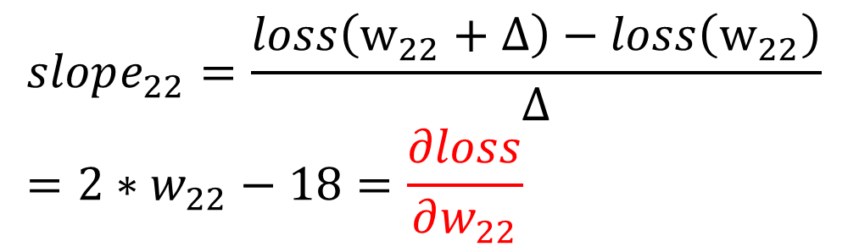
H₁
Loss
w₁₁
w₂₁
x₁
y
w₂₂
w₁₂
H₂
Slope: -
Slope: +
0
9
w₂₂
$$loss=91−18w_{22}+w_{22}^{2}$$
x | y
1 | 10
2 | 20
5 | 30
$$slope_{22}=\frac{loss\left(w_{22}+Δ\right)−loss\left(w_{22}\right)}{Δ}=2∗w_{22}−18=\frac{∂loss}{∂w_{22}}$$

Slide 11
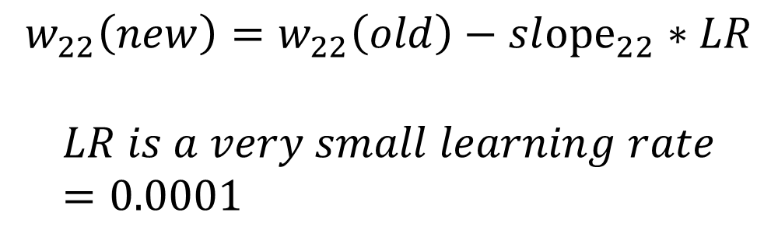
H₁
Loss
w₁₁
w₂₁
x₁
y
w₂₂
w₁₂
H₂
Slope: -
Slope: +
0
9
w₂₂
x | y
1 | 10
2 | 20
5 | 30
$$w_{22}\left(new\right)=w_{22}\left(old\right)−sl{ope}_{22}∗LR$$
$$LR is a very small learning rate=0.0001$$

Slide 12
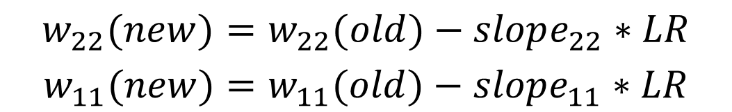
H₁
Loss
w₁₁
w₂₁
x₁
y
w₂₂
w₁₂
H₂
0
w₂₂
w₁₁
$$w_{22}(new)=w_{22}(old)−slope_{22}∗LR$$
$$w_{11}(new)=w_{11}(old)−slope_{11}∗LR$$
x | y
1 | 10
2 | 20
5 | 30

Slide 13

$$w_{22}(new)=w_{22}(old)−slope_{22}∗LR$$
$$w_{11}(new)=w_{11}(old)−slope_{11}∗LR$$
$$w_{12}(new)=w_{12}(old)−slope_{12}∗LR$$
$$w_{21}(new)=w_{21}(old)−slope_{21}∗LR$$
Loss
H₁
w₁₁
w₂₁
x₁
y
w₂₂
w₁₂
H₂
0
w₂₂
w₁₁

Slide 14
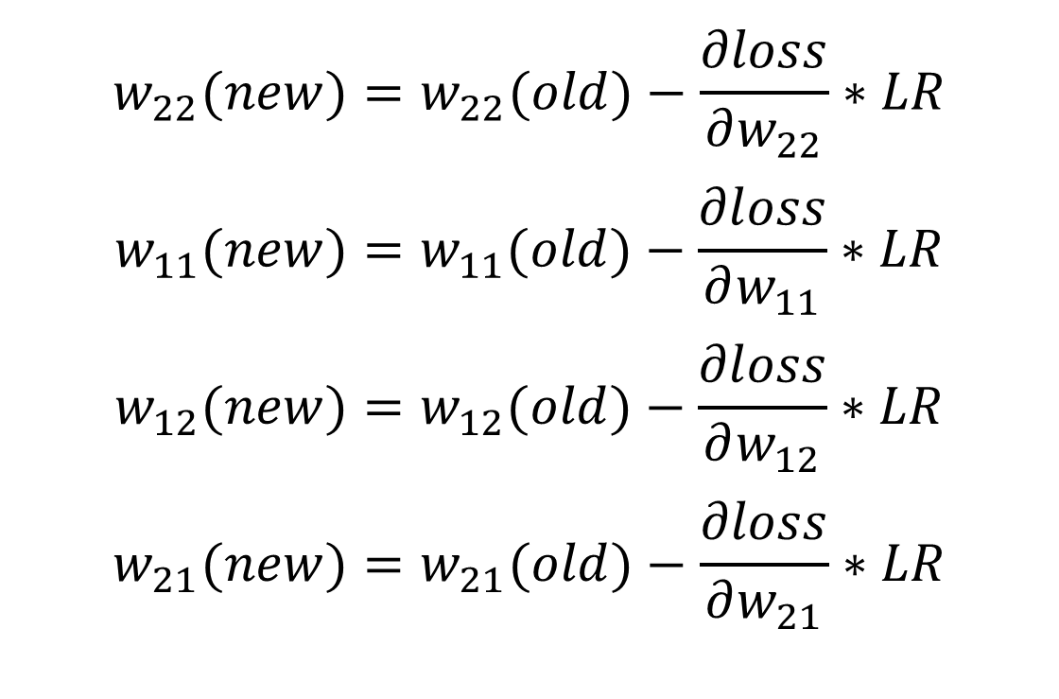
H₁
w₁₁
w₂₁
x₁
y
w₂₂
w₁₂
H₂
$$w_{22}(new)=w_{22}(old)−\frac{∂loss}{∂w_{22}}∗LR$$
$$w_{11}(new)=w_{11}(old)−\frac{∂loss}{∂w_{11}}∗LR$$
$$w_{12}(new)=w_{12}(old)−\frac{∂loss}{∂w_{12}}∗LR$$
$$w_{21}(new)=w_{21}(old)−\frac{∂loss}{∂w_{21}}∗LR$$

Slide 15
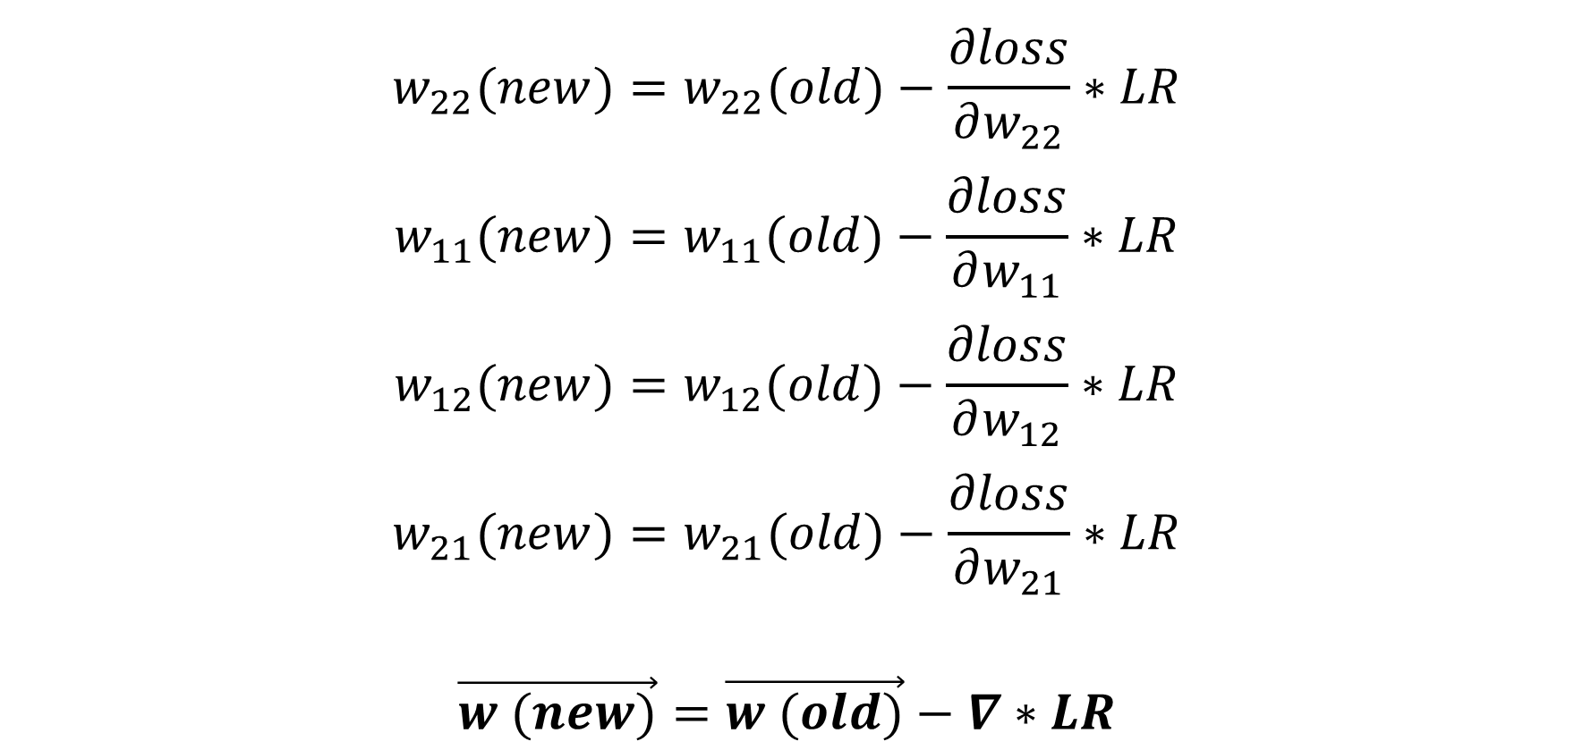
$$w_{22}(new)=w_{22}(old)−\frac{∂loss}{∂w_{22}}∗LR$$
$$w_{11}(new)=w_{11}(old)−\frac{∂loss}{∂w_{11}}∗LR$$
$$w_{12}(new)=w_{12}(old)−\frac{∂loss}{∂w_{12}}∗LR$$
$$w_{21}(new)=w_{21}(old)−\frac{∂loss}{∂w_{21}}∗LR$$
$$\vec{w (new)}=\vec{w (old)}−∇∗LR$$

Slide 16
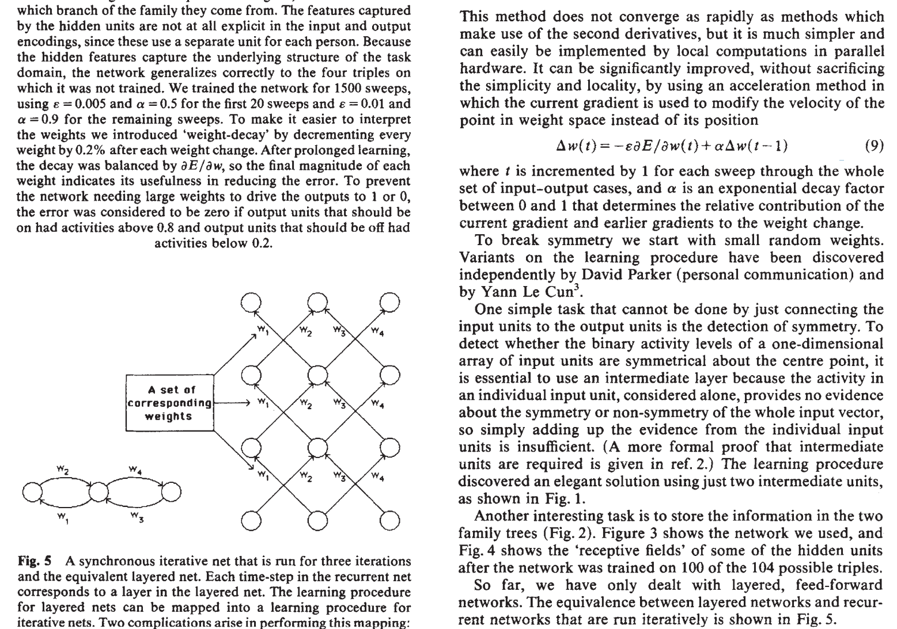
Rumelhart, D. E., Hinton, G. E., & Williams, R. J. (1986). Learning representations by back-propagating errors. nature, 323(6088), 533-536.

Slide 17
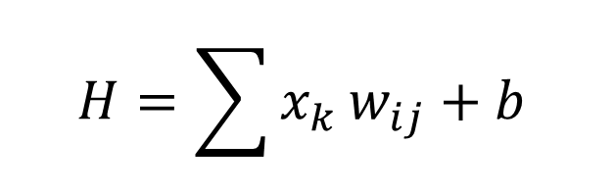
H₁
H
W₂₁
W₁₁
For each neuron H:
x₁
H₂
W₂₂
W₁₂
$$H=\sum{x_{k}}w_{ij}+b$$
y₁
x₂
y₂
w_{ij} is the weight
b is the bias
A DNN has millions of weights and biases
W_{ij}
H_{k}

Slide 18
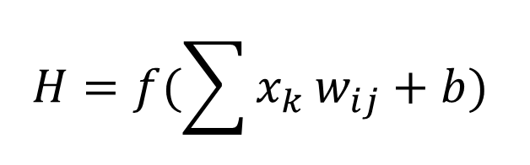
H₁
H
W₂₁
W₁₁
For each neuron H:
x₁
H₂
W₂₂
W₁₂
$$H=f(\sum{x_{k}}w_{ij}+b)$$
y₁
x₂
y₂
f is the activation function
w_{ij} is the weight
b is the bias
A DNN has millions of weights and biases
W_{ij}
H_{k}

Slide 19
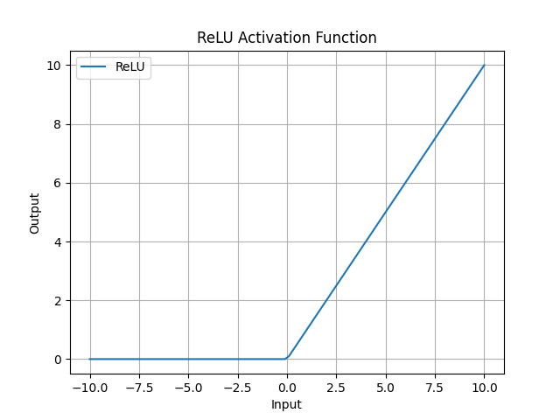

Slide 20
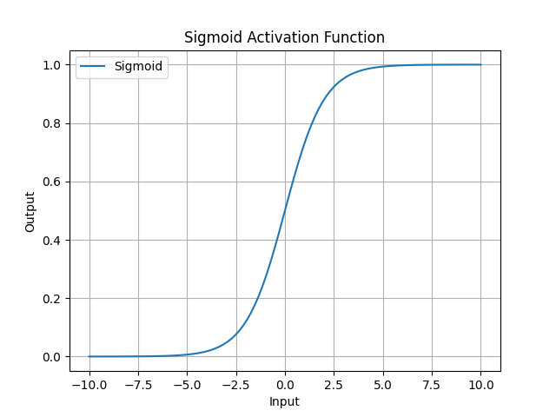

Slide 21
Output types
Regression
Classification
Feature extraction
Combination

Slide 22
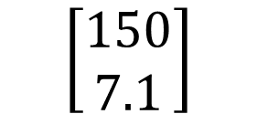
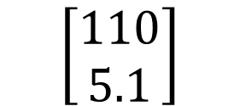
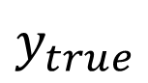
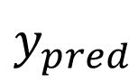
H₁
H
W₂₁
W₁₁
x₁
H₂
W₂₂
W₁₂
y₁
Weight (lbs)
$y_{pred}$
$y_{true}$
x₂
$$\left[\begin{aligned}110 \\ 5.1\end{aligned}\right]$$
$$\left[\begin{aligned}150 \\ 7.1\end{aligned}\right]$$
y₂
Height (feet)
W_{ij}
H_{k}

Slide 23
Regression loss
Mean absolute error
Mean square error
$$MAE=\frac{1}{n}|y_{pred}−y_{true}|$$
$$MSE=\frac{1}{n}{\left(y_{pred}−y_{true}\right)}^{2}$$

Slide 24
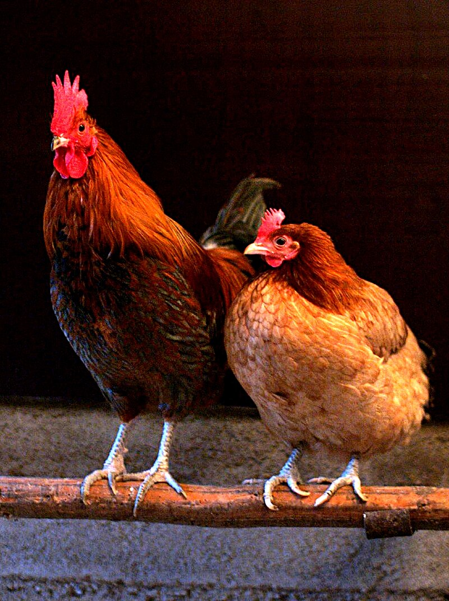
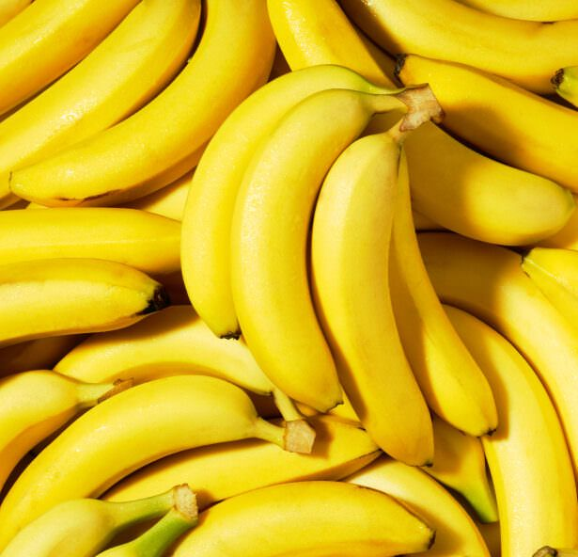
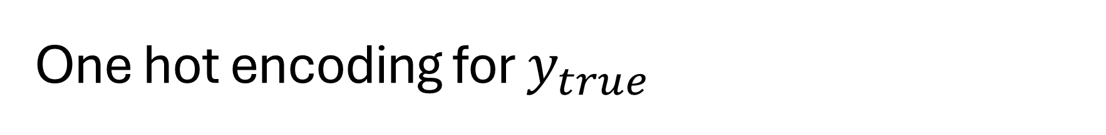
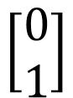
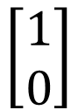
One hot encoding for $y_{true}$
$$\left[\begin{aligned}1 \\ 0\end{aligned}\right]$$
Chicken
Banana
$$\left[\begin{aligned}0 \\ 1\end{aligned}\right]$$

Slide 25

Softmax for y_pred

Slide 26

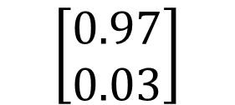
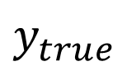
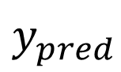
H₁
H
W₂₁
W₁₁
x₁
H₂
W₂₂
W₁₂
y₁
Chicken
$y_{pred}$
$y_{true}$
x₂
$$\left[\begin{aligned}0.97 \\ 0.03\end{aligned}\right]$$
$$\left[\begin{aligned}1 \\ 0\end{aligned}\right]$$
y₂
Banana
W_{ij}
H_{k}

Slide 27
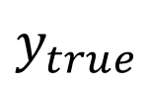
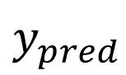
H₁
H
W₂₁
W₁₁
$y_{pred}$
$y_{true}$
x₁
H₂
W₂₂
W₁₂
y₁
Recommend
Engaged
x₂
y₂
Not Recommend
Not Engaged
W_{ij}
H_{k}

Slide 28
Cross entropy loss for classification
Binary cross entropy
After softmax
Multi class entropy
After softmax
$$BCE=−\sum{y_{true}∗\log\left(y_{pred}\right)+\left(1−y_{true}\right)∗log⁡(1−y_{pred})}$$
$$CE=−\sum{y_{true}∗\log\left(y_{pred}\right)}$$

Slide 29
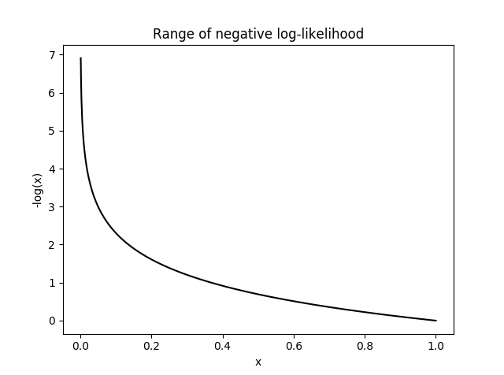

Slide 30
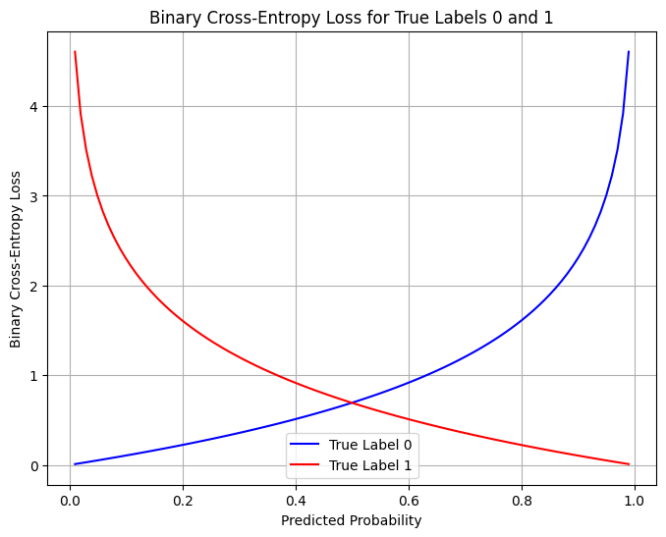

Slide 31

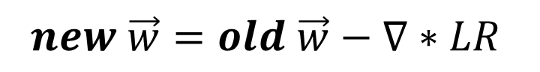
Weight update
H₁
H
W₂₁
W₁₁
x₁
H₂
W₂₂
W₁₂
Learn
Fit
Train
Back propagation
y_{1_true}
y₁
x₂
$$loss$$
y₂
y_{2_true}
W_{ij}
H_{k}
$$new \vec{w}=old \vec{w}−∇∗LR$$

Slide 32

Use the model
H₁
H
W₂₁
W₁₁
x₁
H₂
W₂₂
W₁₂
Forward pass
Inference
Test
Validation
Deployment
y₁
x₂
y₂
W_{ij}
H_{k}
$$NN\left(\vec{x}\right)=\vec{y}$$

Slide 33
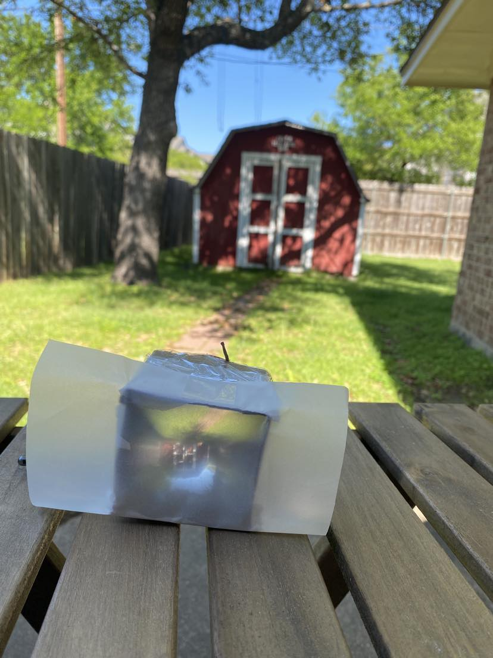
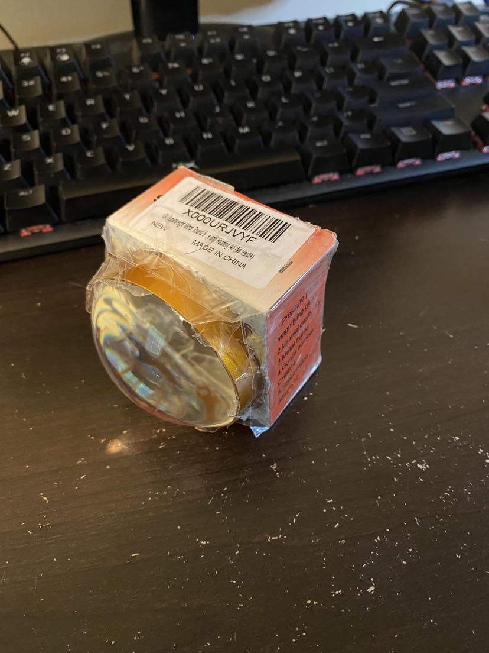

Slide 34
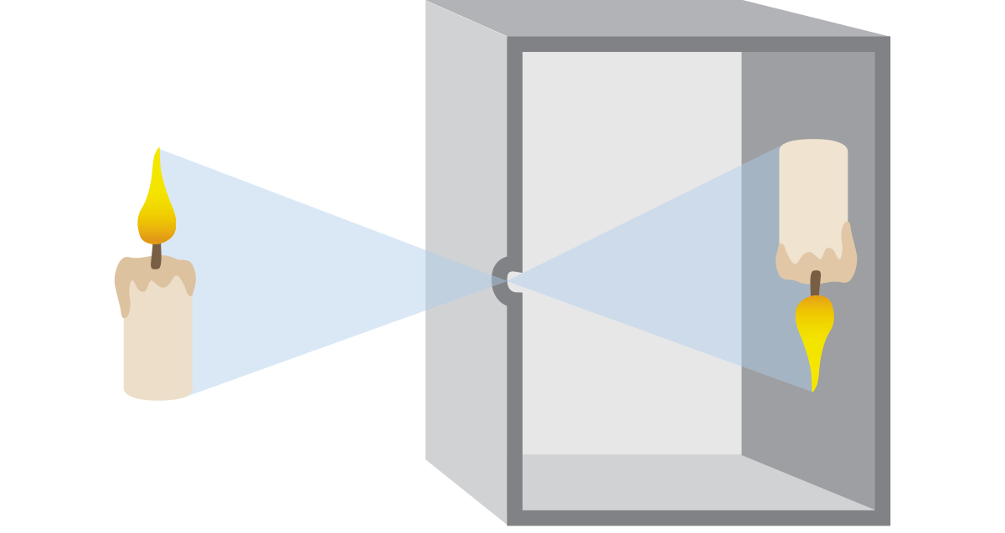
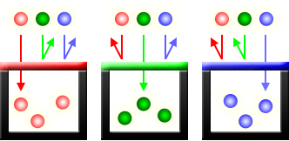
Pinhole principle
Traditional film
Digital sensors (CCD and CMOS)
Red Green Blue (RGB) channels

Slide 35
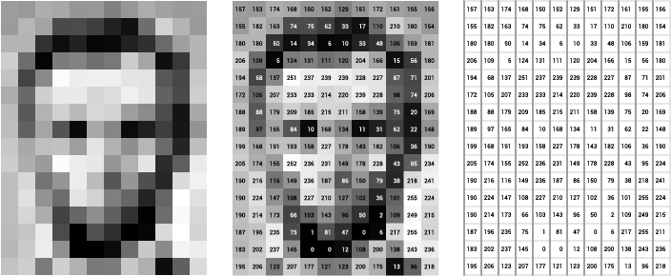
Grey Scale
Image of Abraham Lincoln as a matrix of pixel values. Image Credit: Thomas Smits

Slide 36
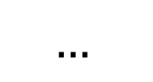
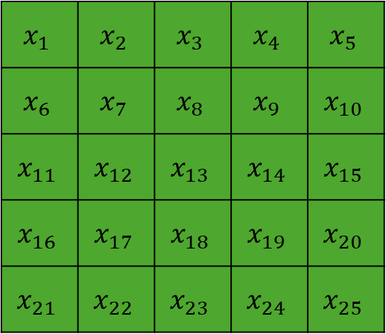
H₁
H
W₂₁
W₁₁
$$x_{1}$$ | $$x_{2}$$ | $$x_{3}$$ | $$x_{4}$$ | $$x_{5}$$
$$x_{6}$$ | $$x_{7}$$ | $$x_{8}$$ | $$x_{9}$$ | $$x_{10}$$
$$x_{11}$$ | $$x_{12}$$ | $$x_{13}$$ | $$x_{14}$$ | $$x_{15}$$
$$x_{16}$$ | $$x_{17}$$ | $$x_{18}$$ | $$x_{19}$$ | $$x_{20}$$
$$x_{21}$$ | $$x_{22}$$ | $$x_{23}$$ | $$x_{24}$$ | $$x_{25}$$
x₁
H₂
W₂₂
W₁₂
y₁
x₂
$$…$$
y₂
W_{ij}
H_{k}

Slide 37
Computer vision

Slide 38
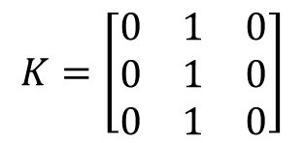
Convolution Computation
7 | 7 | 7 | 7 | 5
7 | 7 | 7 | 5 | 5
7 | 7 | 5 | 5 | 5
7 | 5 | 5 | 5 | 5
5 | 5 | 5 | 5 | 5
7 | 7 | 7 | 7 | 5
7 | 7 | 7 | 5 | 5
7 | 7 | 5 | 5 | 5
7 | 5 | 5 | 5 | 5
5 | 5 | 5 | 5 | 5
7 | 7 | 7 | 7 | 5
7 | 7 | 7 | 5 | 5
7 | 7 | 5 | 5 | 5
7 | 5 | 5 | 5 | 5
5 | 5 | 5 | 5 | 5
$$K=\left[\begin{matrix}0 & 1 & 0 \\ 0 & 1 & 0 \\ 0 & 1 & 0\end{matrix}\right]$$
0 | 0 | 0 | 0 | 0
0 | 21 | 19 | 17 | 0
0 | 19 | 17 | 15 | 0
0 | 17 | 15 | 15 | 0
0 | 0 | 0 | 0 | 0
Kernel at position 1
Kernel at position 2
Kernel at position n

Slide 39
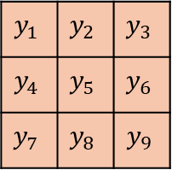
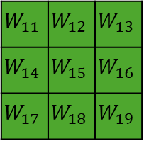
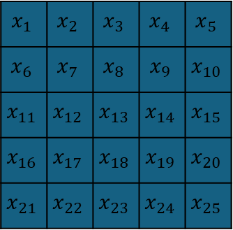
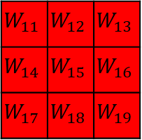
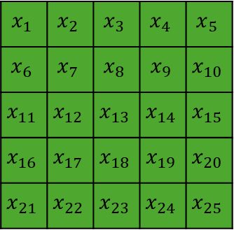
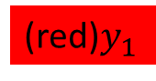
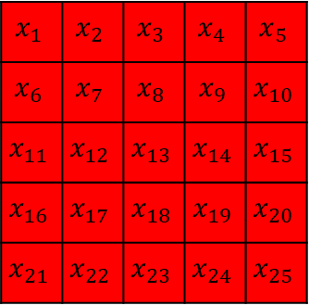
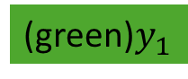
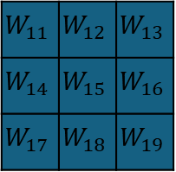

$$x_{1}$$ | $$x_{2}$$ | $$x_{3}$$ | $$x_{4}$$ | $$x_{5}$$
$$x_{6}$$ | $$x_{7}$$ | $$x_{8}$$ | $$x_{9}$$ | $$x_{10}$$
$$x_{11}$$ | $$x_{12}$$ | $$x_{13}$$ | $$x_{14}$$ | $$x_{15}$$
$$x_{16}$$ | $$x_{17}$$ | $$x_{18}$$ | $$x_{19}$$ | $$x_{20}$$
$$x_{21}$$ | $$x_{22}$$ | $$x_{23}$$ | $$x_{24}$$ | $$x_{25}$$
$$x_{1}$$ | $$x_{2}$$ | $$x_{3}$$ | $$x_{4}$$ | $$x_{5}$$
$$x_{6}$$ | $$x_{7}$$ | $$x_{8}$$ | $$x_{9}$$ | $$x_{10}$$
$$x_{11}$$ | $$x_{12}$$ | $$x_{13}$$ | $$x_{14}$$ | $$x_{15}$$
$$x_{16}$$ | $$x_{17}$$ | $$x_{18}$$ | $$x_{19}$$ | $$x_{20}$$
$$x_{21}$$ | $$x_{22}$$ | $$x_{23}$$ | $$x_{24}$$ | $$x_{25}$$
$$x_{1}$$ | $$x_{2}$$ | $$x_{3}$$ | $$x_{4}$$ | $$x_{5}$$
$$x_{6}$$ | $$x_{7}$$ | $$x_{8}$$ | $$x_{9}$$ | $$x_{10}$$
$$x_{11}$$ | $$x_{12}$$ | $$x_{13}$$ | $$x_{14}$$ | $$x_{15}$$
$$x_{16}$$ | $$x_{17}$$ | $$x_{18}$$ | $$x_{19}$$ | $$x_{20}$$
$$x_{21}$$ | $$x_{22}$$ | $$x_{23}$$ | $$x_{24}$$ | $$x_{25}$$
$$y_{1}$$ | $$y_{2}$$ | $$y_{3}$$
$$y_{4}$$ | $$y_{5}$$ | $$y_{6}$$
$$y_{7}$$ | $$y_{8}$$ | $$y_{9}$$
Input matrix: 5x5x3
(red)$y_{1}$
$$W_{11}$$ | $$W_{12}$$ | $$W_{13}$$
$$W_{14}$$ | $$W_{15}$$ | $$W_{16}$$
$$W_{17}$$ | $$W_{18}$$ | $$W_{19}$$
$$W_{11}$$ | $$W_{12}$$ | $$W_{13}$$
$$W_{14}$$ | $$W_{15}$$ | $$W_{16}$$
$$W_{17}$$ | $$W_{18}$$ | $$W_{19}$$
$$W_{11}$$ | $$W_{12}$$ | $$W_{13}$$
$$W_{14}$$ | $$W_{15}$$ | $$W_{16}$$
$$W_{17}$$ | $$W_{18}$$ | $$W_{19}$$
(green)$y_{1}$
Output size: 3x3x2
(blue)$y_{1}$
Kernel size: 3x3x3

Slide 40




Convolutional Nueral Network
$$y_{1},y_{2},…y_{n}$$
…
…
RGB Input
(128x128x3)
50 filters
(3x3x3)
Tensor
(128x128x50)
$k$ filters
(3x3x50)
Output
(1000 classes)
…

Slide 41

Image augmentation
Horizontal Flip
Vertical Flip

Slide 42



Image augmentation
Rotation
Zoom
Brightness
…
90⁰
135⁰
45⁰
0⁰
180⁰
315⁰
225⁰
270⁰

Slide 43

Large dataset
COCO: https://cocodataset.org/#home (80 classes)
ImageNet (1000 classes with 1.3M labeled images)
Common Crawl (~100TB+)

Slide 44


Transfer learning
$$y_{1},y_{2},…y_{80}$$
…
…
…
Input
Convolution layer
Output (80)

Slide 45

Transfer learning
$$y_{1},y_{2},…$$
…
…
…
Input
Convolution layer
Output (24)

Slide 46
Resnet
y
…
…
Input
Residual block
Output

Slide 47

Image Credit: Linkedin.com

Slide 48
Underfitting
Overfitting
Loss
Validation
Training
0
Epoch

Slide 49
Auto encoder decoder
H₁
H
H₁
H
W₂₁
W₂₁
W₁₁
W₁₁
x₁
H₂
W₂₂
x₁
H₂
W₂₂
W₁₂
W₁₂
x₂
…
x₂
W_{ij}
W_{ij}
H_{k}
H_{k}

Slide 50

CNN Auto-encoder-decoder
Input
Encoder
Bottleneck
Decoder
Output

Slide 51


Natural language processing
Chat-GPT: Chat Generative Pre-trained Transformer
Tokenization and vectorization
Attention

Slide 52


Code faster
Cui, Zheyuan Kevin, et al. "The effects of generative ai on high skilled work: Evidence from three field experiments with software developers." Available at SSRN 4945566 (2024).

Slide 53
Tokenization
“I want pizza”
“我想要披萨”
“ピザが欲しいです”
“Eu quero pizza”
“أريد بيتزا ”
“मुझे पिज़्ज़ा चाहिए”
“Quiero pizza”
“피자가 먹고 싶어요”

Slide 54

… | I | want | pizza | … | spore | …
Total Text Corpus
Embedding | 1 | 2 | 3 | … | n
… | … | … | … | … | …
I | $$e_{i1}$$ | $$e_{i2}$$ | $$e_{i3}$$ | … | $$e_{in}$$
want | $$e_{w1}$$ | $$e_{w2}$$ | $$e_{w3}$$ | … | $$e_{wn}$$
pizza | $$e_{p1}$$ | $$e_{p2}$$ | $$e_{p3}$$ | … | $$e_{pn}$$
… | … | … | … | … | …
spore | $$e_{s1}$$ | $$e_{s2}$$ | $$e_{s3}$$ | … | $$e_{sn}$$
… | … | … | … | … | …
Embedding 1
I
pizza
want
spore
Embedding 2
Embedding 3

Slide 55




… | I | want | pizza | … | spore | …
$$new \vec{w}=old \vec{w}−∇∗LR$$
Positive:
$$\left[I, pizza\right]$$
$$[I, want]$$
…
Negative:
$$\left[I, spore\right]$$
…
A hands-on intuitive approach to Deep Learning Methods for Text Data – Word2Vec, GloVe and FastText

Slide 56
Turning words to numbers
Tokenization: https://tiktokenizer.vercel.app/
Vectorization: https://projector.tensorflow.org/
Does not work with math:
https://grok.com/
https://copilot.microsoft.com
https://chatgpt.com/
67544*090766*0.00987*0.9876

Slide 57


Slide 58


Cosine similarity
Vector A and B
Range from -1 to 1 -> not similar to similar
$\cos\left(θ\right)=\frac{A ∙B}{\left|\left|A\right|\right||\left|B\right||}$= $\frac{\sum_{i=1}^{n}{A_{i}B_{i}}}{\sqrt{\sum_{i=1}^{n}{A_{i}^{2}}}\sqrt{\sum_{i=1}^{n}{B_{i}^{2}}}}$

Slide 59


Slide 60


Slide 61


Slide 62
CV and NLP
Deep neural networks: CV->NLP
Transformer: NLP->CV

Slide 63
Generative AI
AI: Neural Network
Image
Text
Videos
Audio
Others

Slide 64
Auto encoder decoder
H₁
H
H₁
H
W₂₁
W₂₁
W₁₁
W₁₁
x₁
H₂
W₂₂
x₁
H₂
W₂₂
W₁₂
W₁₂
x₂
…
x₂
W_{ij}
W_{ij}
H_{k}
H_{k}

Slide 65
CNN Auto-encoder-decoder
Input
Encoder
Latent Space
Decoder
Output

Slide 66

Applications
Data compression
Image search
Topic modeling
Image coloring
Translation
Generative AI
Anomaly detection

Slide 67


Slide 68













Generative Adversarial Networks (GANs)
Prediction
Real Images
Discriminator
Real
Fake
Generator
Noise
Fake Images
$$\min_{G}{\max_{D}\left(D,G\right)=\log\left(D\left(x\right)\right)+log⁡(1−D(G(z)))}$$

Slide 69




GAN APPLICATIONS
pix2pixHD

Slide 70

Matrix review
$$\left[\begin{matrix}a & b \\ c & d\end{matrix}\right]\left[\begin{matrix}e \\ f\end{matrix}\right]=\left[\begin{matrix}a∗e+b∗f \\ c∗e+d∗f\end{matrix}\right]$$
2x2
2x1
2x1
2x1

Slide 71

Attention
Word | Dim 1 | Dim 2 | Dim 3 | Dim 4
I | 0.23 | -0.48 | 0.77 | 0.12
want | -0.61 | 0.35 | -0.10 | 0.56
pizza | 0.44 | 0.89 | -0.33 | -0.21
$$=Q=K=V$$
3x4
$$attention=\left(QK^{T}\right)V$$
3x4
4x3
3x3
3x4
3x4

Slide 72




Probability for each word in the vocabulary
$$attention=\left(QK^{T}\right)V$$
3x4
4x3
3x3
3x4
 | I | want | pizza
I | 1.577172 | 0.912275 | 0.97867
want | 0.912275 | 1.347627 | 0.946706
pizza | 0.97867 | 0.946706 | 1.185419
3x4
$$Q$$
$$K$$
$$V$$
Vaswani, A. (2017). Attention is all you need. Advances in Neural Information Processing Systems.

Slide 73
 | I | want | pizza
I | 1.577172 | 0 | 0
want | 0.912275 | 1.347627 | 0
pizza | 0.97867 | 0.946706 | 1.185419
Word | Dim 1 | Dim 2 | Dim 3 | Dim 4
I | 0.23 | -0.48 | 0.77 | 0.12
want | -0.61 | 0.35 | -0.10 | 0.56
pizza | 0.44 | 0.89 | -0.33 | -0.21
3x3
3x4
$$masked attention=\left(QK^{T}\right)V$$
3x4
4x3
3x3
3x4
3x4

Slide 74

Probability | 0.07 | 0.91 | 0.01 | … | 0.00 | …
Vocabulary | want | from | pizza | … | spore | …
Input window |  |  | Next
I | want | pizza | ____
want | pizza | from | ____
… | … | … | …
Word | Dim 1 | Dim 2 | Dim 3 | Dim 4
I | 0.23 | -0.48 | 0.77 | 0.12
want | -0.61 | 0.35 | -0.10 | 0.56
pizza | 0.44 | 0.89 | -0.33 | -0.21
Radford, A., Narasimhan, K., Salimans, T., & Sutskever, I. (2018). Improving language understanding by generative pre-training.

Slide 75

Perplexity
For each word i, the positive prediction is y_pred
W is the total number of words in the test corpus S
Minimizing perplexity = maximizing probability
$$perplexity\left(S\right)=2^{(−\frac{1}{W}\sum_{i=1}^{n}{\log_{2}⁡(y_{pred,i})) }}$$

Slide 76

BLEU
Candidate: I want pizza
Reference: I want fired rice
$$precision=\frac{\# overlapping words}{\# candidate words}=\frac{2}{3}$$
$$recall=\frac{\# overlapping words}{\# reference words}=\frac{2}{4}$$

Slide 77

N-gram BLEU
2-gram BLEU
Candidate: [“I want”, “want pizza”]
Reference: [ “I want”, “want fired”, “fried rice”]
3-gram BELU
$$BLEU=\prod_{i=1}^{N}{p_{i}}$$

Slide 78
GPT 3
Parameters 175 B
Dataset 45T
96 attention heads
2048 token size
Learn from their chief scientist: https://www.youtube.com/watch?v=kCc8FmEb1nY

Slide 79

Contrastive Language-Image Pre-training (CLIP)

Slide 80
Stable Diffusion
400 million pairs for training for CLIP
Text conditioning
https://poloclub.github.io/diffusion-explainer/
3 Brown 1 Blue: https://www.youtube.com/watch?v=iv-5mZ_9CPY&t=496s

Slide 81



Slide 82


Slide 83
Append Text Embedding

Slide 84


Add the hat on the cat
InstructPix2Pix: Learning to Follow Image Editing Instructions

Slide 85

Rombach, R., Blattmann, A., Lorenz, D., Esser, P., & Ommer, B. (2022). High-resolution image synthesis with latent diffusion models. In Proceedings of the IEEE/CVF conference on computer vision and pattern recognition (pp. 10684-10695).

Slide 86

Survey

